Slide 1
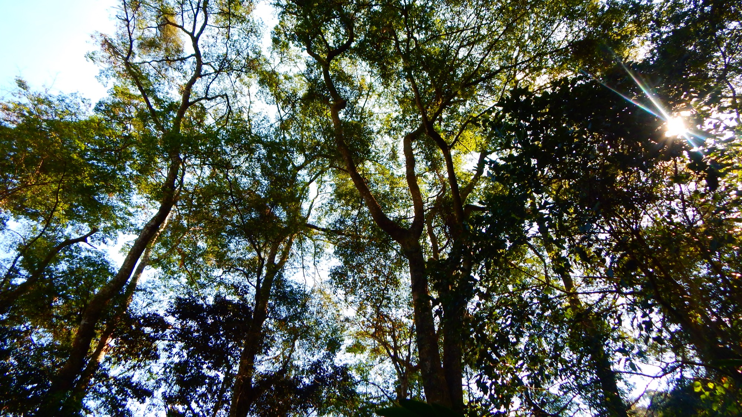
WOODY PLANT BASICS Led by Cat Chamberlain, Wayne Daly, Morgan Furze, Anju Manandhar

Slide 2
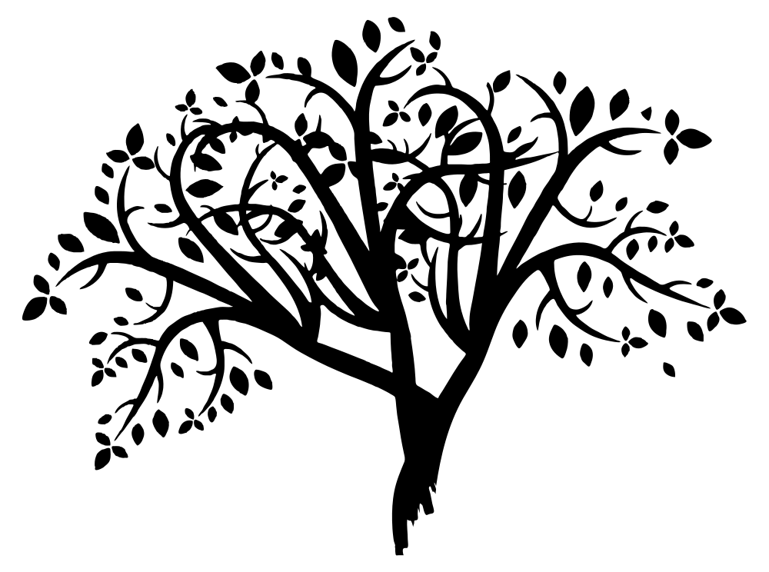
MAIN AIMS
🌸
Temperate Trees
General Plant Functioning
Flowers to Fruits to Seeds
🍎

Slide 3
General Terms:
TEMPERATE
https://content.meteoblue.com/en/meteoscool/general-climate-zones

Slide 4
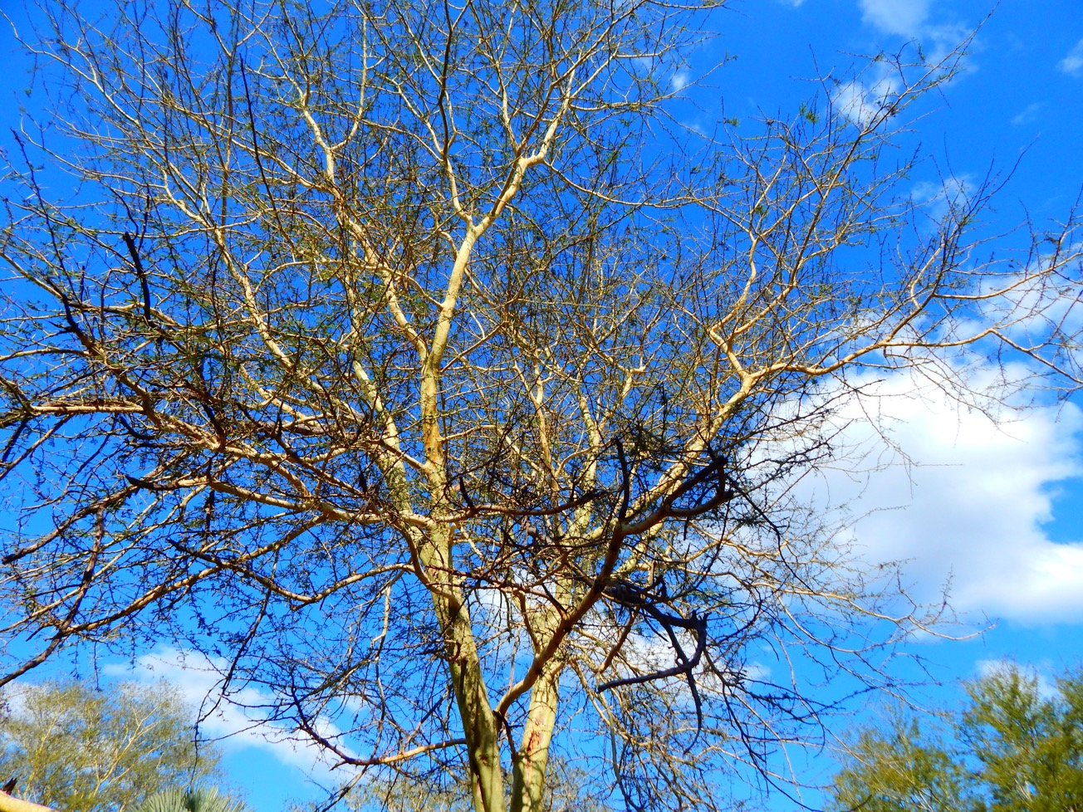
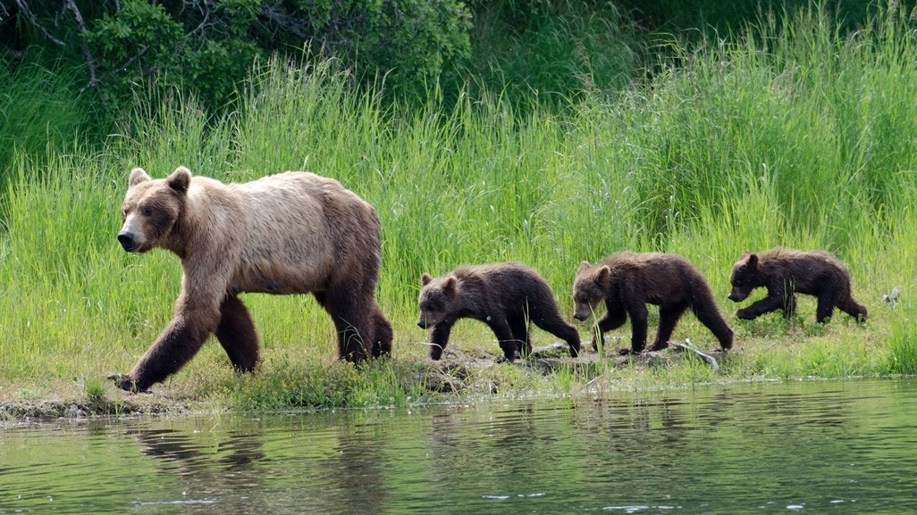
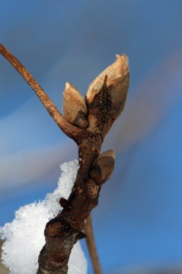
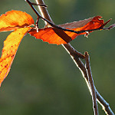
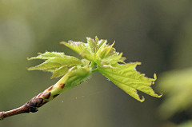
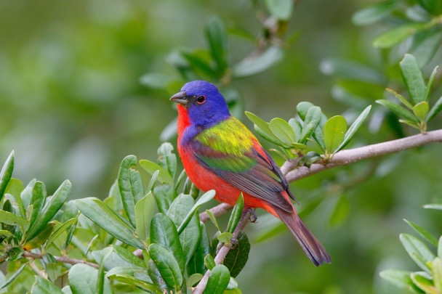
PHENOLOGY:
the timing of recurring life history events
COLD HARDINESS:
Freezing resistance through the phenophases
Charrier & Améglio, 2011; Vitasse et al., 2014
Notes:
freezing resistance
remove phases of dormancy

Slide 5
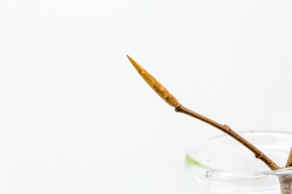
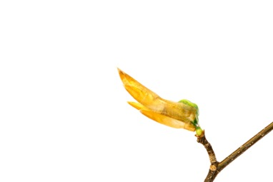
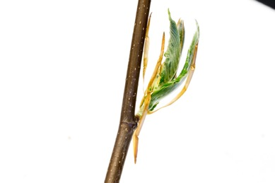
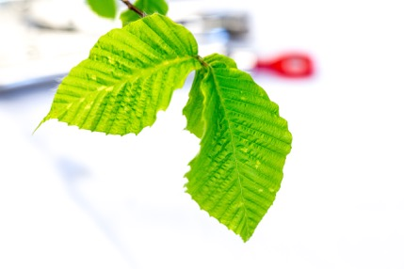
American Beech: Fagus sylvatica
DORMANT BUD
BUDBURST
LEAFOUT

Slide 6
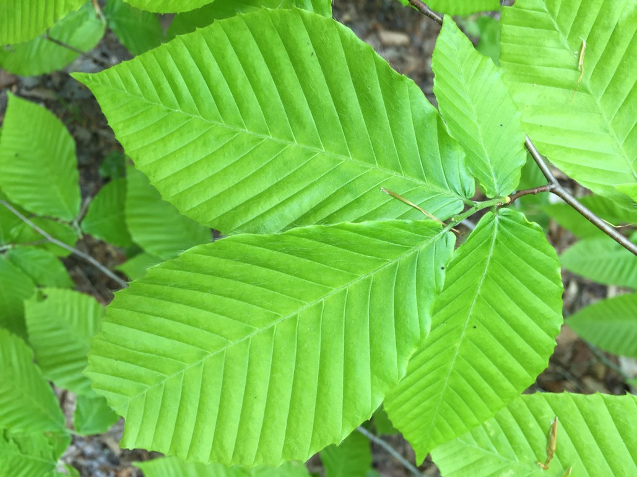
PLANT FUNCTIONING: Physiology
PHOTOSYNTHESIS
RESPIRATION
XYLEM
PHLOEM

Slide 7
Photosynthesis
CO₂ + water + light energy = glucose + oxygen
Notes:
Photosynthesis – convert energy from sunlight into sugar
Oxygen is released (i.e. “exhaled”) through stomata
Respiration – occurs in all living cells, doesn’t require sunlight so can happen any time in the day

Slide 8
Notes:
Missy’s video – 0:33 to 2:51 ish

Slide 9
Photosynthesis
CO₂ + water + light energy = glucose + oxygen
Respiration
glucose + oxygen = CO₂ + water + energy
Notes:
Photosynthesis – convert energy from sunlight into sugar
Oxygen is released (i.e. “exhaled”) through stomata
Respiration – occurs in all living cells, doesn’t require sunlight so can happen any time in the day

Slide 10
XYLEM: vascular tissue in plants that conducts water upward from the roots to the leaves
COHESION-TENSION THEORY
Notes:
Missy – 11:30 to 13:30

Slide 11
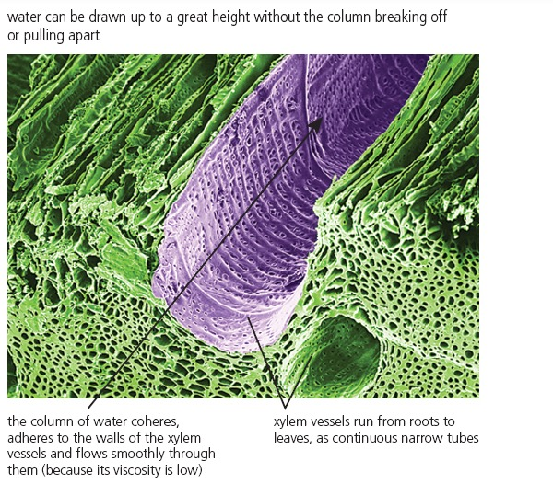
http://ebooks.dynamic-learning.co.uk/prod_content/extracted_books
Notes:
Missy – 1:15 to 3:56 to introduce phloem

Slide 12
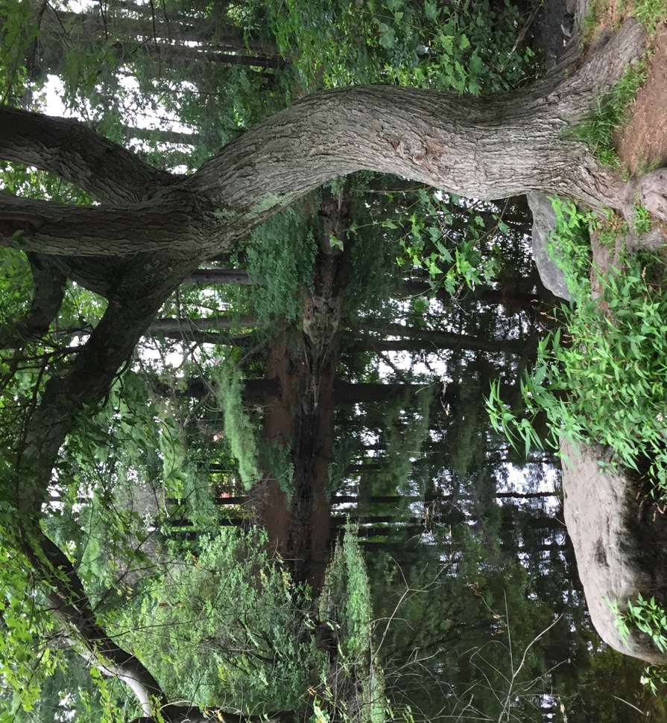
Plant Physiology, 5th Edition – Taiz & Zeiger

Slide 13
Reproduction:
Flowers to Fruits
MONOECIOUS
(one house)
DIOECIOUS
(two houses)
🌸
🌼
🌺

Slide 14
https://www.proflowers.com/blog/flower-anatomy

Slide 15
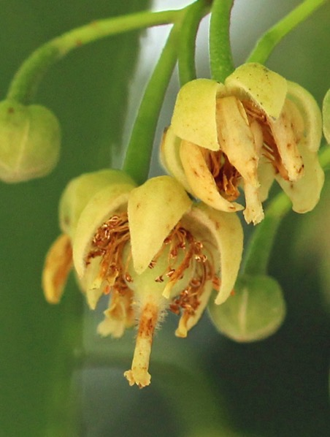
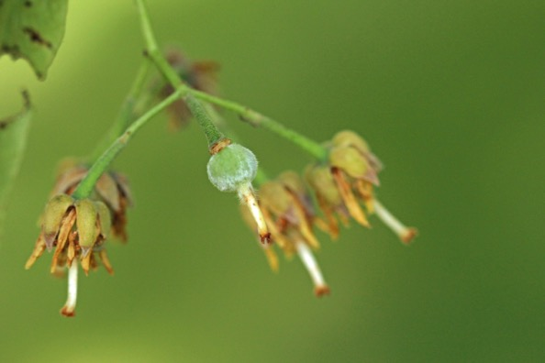
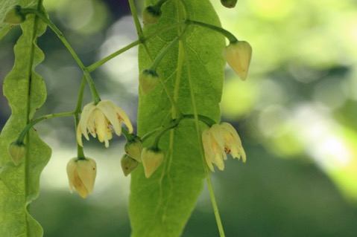
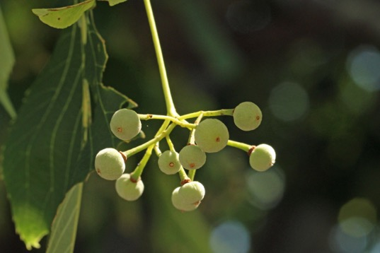
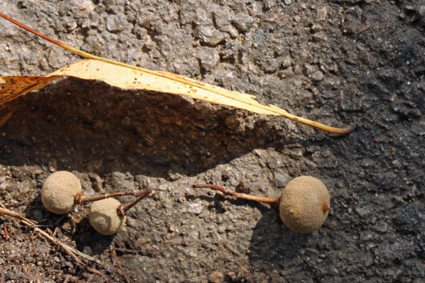
American Linden: Tilia americana
(Monoecious)
Photo Credit: Suz Mrozak

Slide 16
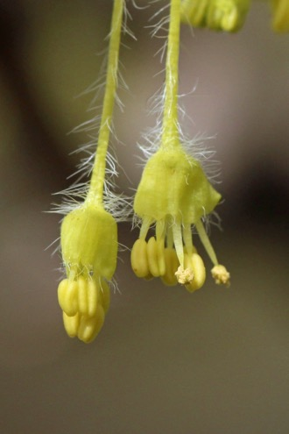
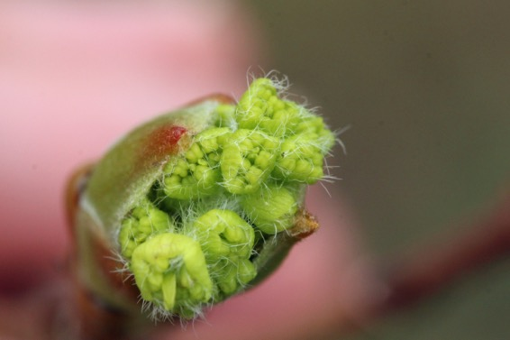
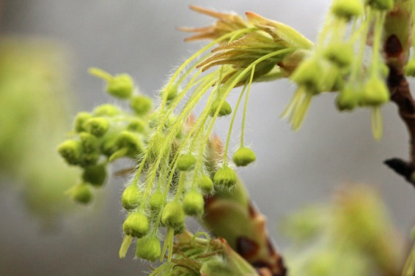
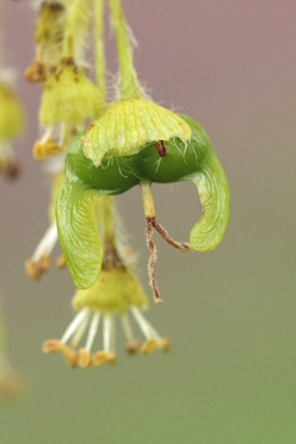
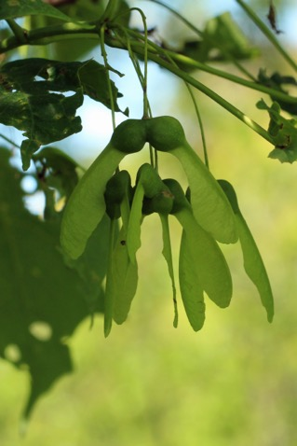
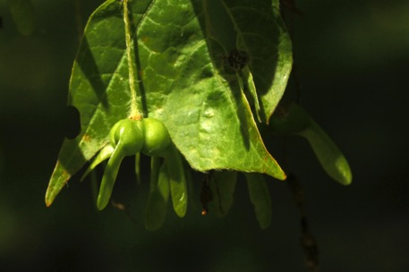
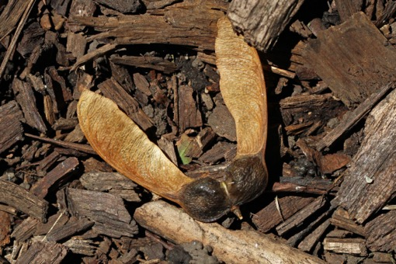
Sugar Maple: Acer saccharum
(Monoecious or Dioecious)
Photo Credit: Suz Mrozak

Slide 17
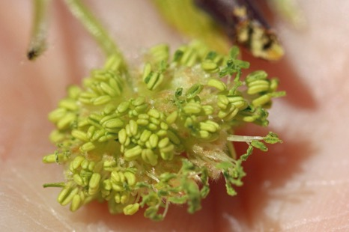
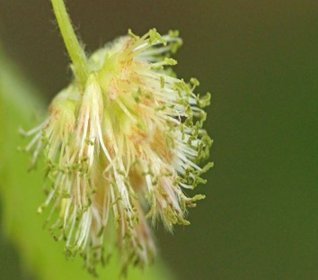
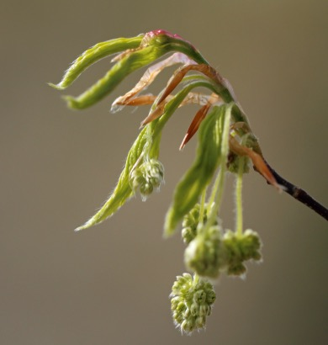
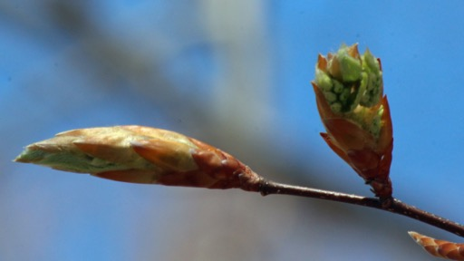
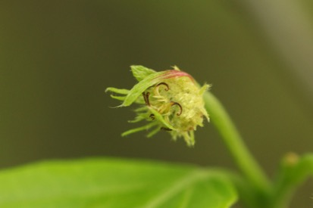
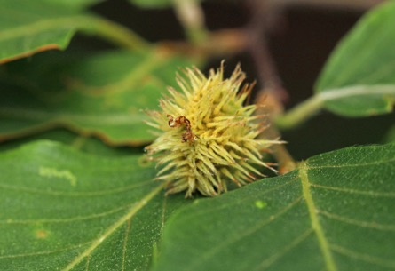
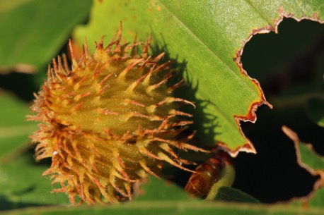
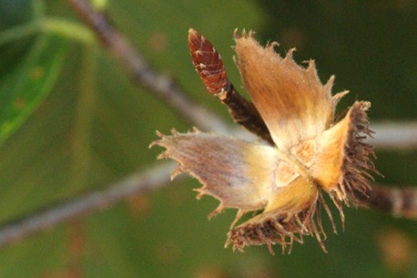
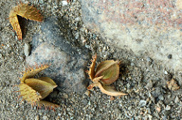
American Beech: Fagus grandifolia
(Monoecious)
♂
♂
♀
Photo Credit: Suz Mrozak

Slide 18
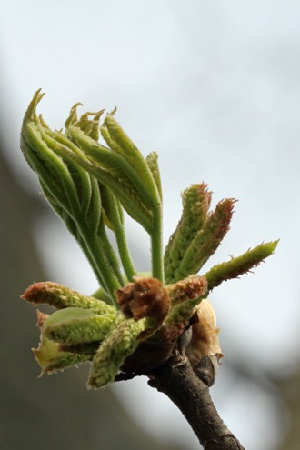
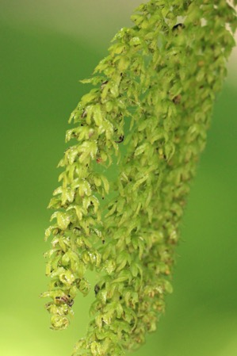
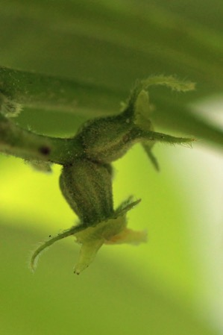
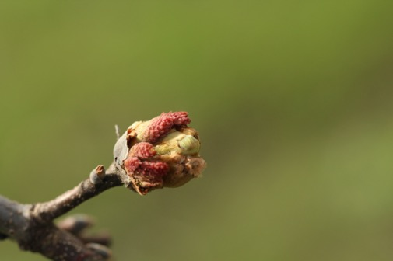
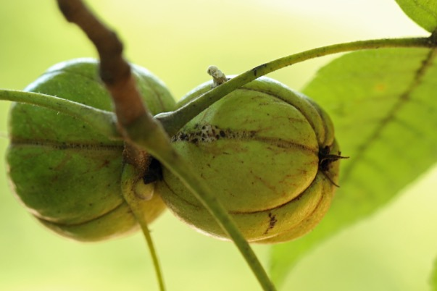
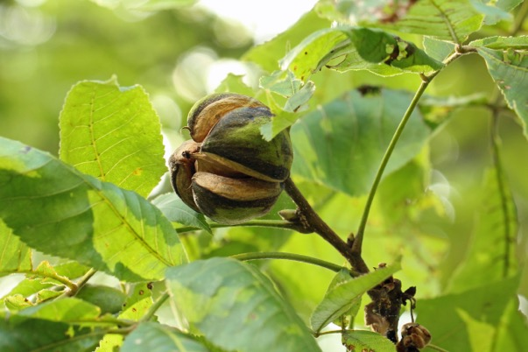
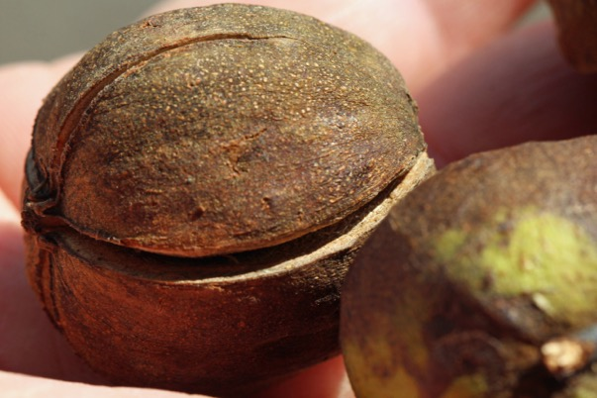
Shagbark Hickory: Carya ovata
(Monoecious)
♂
♀
Photo Credit: Suz Mrozak

Slide 19
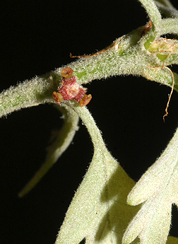
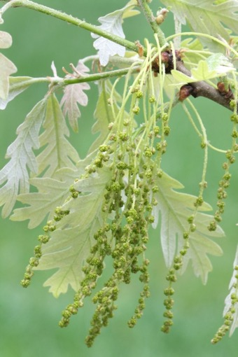
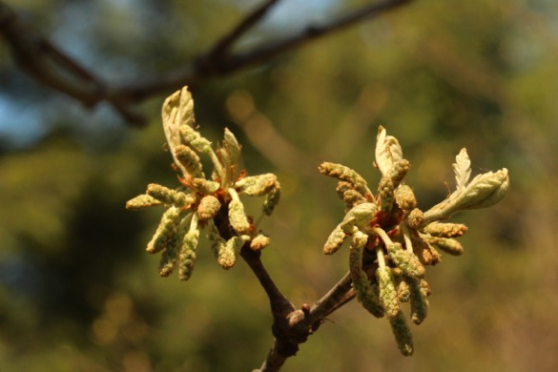
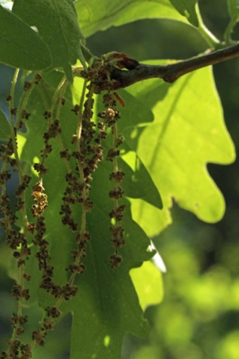
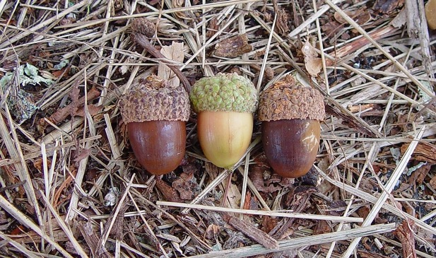
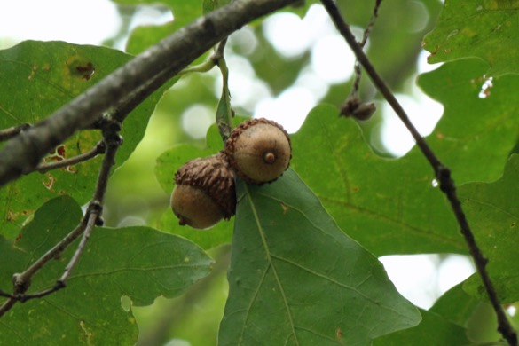
White Oak: Quercus alba
(Monoecious)
♀
♂
Photo Credit: Suz Mrozak and Go Botany

Slide 20
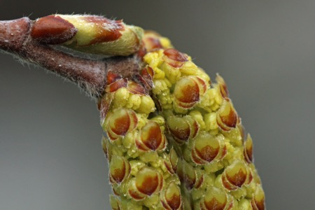






River Birch: Betula nigra
(Monoecious)
♀
♂
♀
♂
Photo Credit: Suz Mrozak

Slide 21






Eastern Cottonwood: Populus deltoides
(Dioecious)
♀
♂
♂
Photo Credit: Suz Mrozak

Slide 22






Yellow Buckeye: Aesculus flava
(Monoecious)
Photo Credit: Suz Mrozak

Slide 23
DEFINITIONS SHEET
General Terms:
Plant Functioning:
Reproduction:
PHOTOSYNTHESIS: the conversion of light energy to chemical energy by pigments that use water and CO₂ to produce carbohydrates
RESPIRATION: when glucose and oxygen combine to produce useable energy
STOMATA: pore in leaf that controls gas exchange (water & CO₂)
VASCULAR: plant tissues that conduct water, sap, and nutrients in flowering plants
XYLEM: vascular tissue in plants that conducts water upward from the roots to the leaves and helps with support (unidirectional)
PHLOEM: vascular tissue in plants that conducts sugars and carbohydrates from the source to the sink (bidirectional)
POLLINATION: process of pollen being transferred to the female reproductive organs of the plant
TEMPERATE: a region or climate characterized by mild temperatures
PHYSIOLOGY: the study of the normal functions of living organisms and their parts
PHENOLOGY: the timing of recurring life history events
DECIDUOUS: a tree or shrub that sheds leaves annually
COLD HARDINESS: a plant’s ability to resist freezing temperatures
ANGIOSPERMS: flowering plants, includes herbs, shrubs, grasses and most trees
GYMNOSPERMS: a plant with seeds unprotected by a fruit, includes conifers, cycads, and ginkgo
MONOECIOUS: male and female flowers on same individual
DIOECIOUS: male and female flowers on separate individuals
PETAL: give flower its shape, often brightly colored if insect pollinated
SEPAL: small, leaf-like parts at base of petals. Help protect the flower before it blossoms
PEDUNCLE: stem or stalk of a flower
PISTIL: female organ of the flower
Stigma: head of pistil, receives pollen
Style: stalk of the pistil
Ovary: base of pistil
Ovules: eggs of the flower, grows into a seed eventually
STAMEN: male organ of the flower
Anther: head of stamen, produces pollen
Filament: holds the anther

